Slide 1
Teck Ghee Arc 402

Slide 2
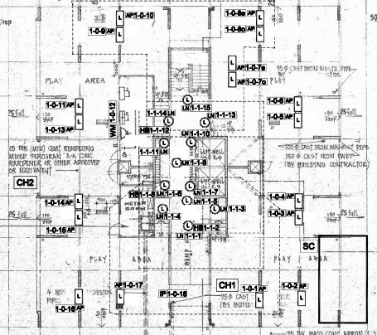
Block 402 1st STOREY FLOOR PLAN

Slide 3
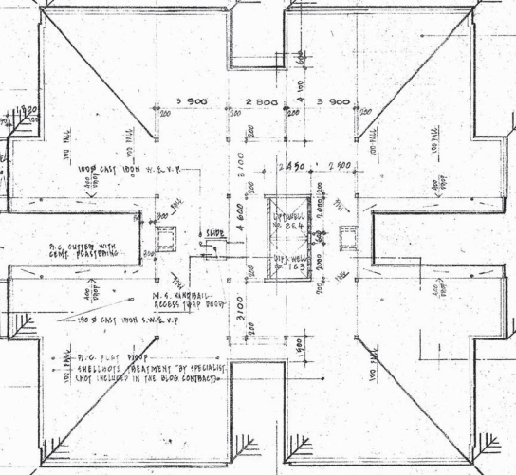
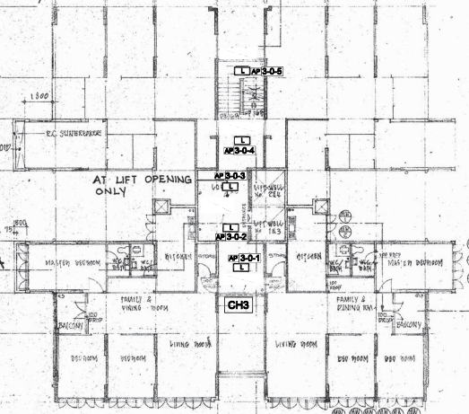
SWITCH ROOM
STAIR
PUMP ROOM
A
LOBBY
B

Slide 4
Block 402 2nd TO 25th STOREY FLOOR PLAN

Slide 5
STAIR
613
615
A
LOBBY
B
COMMON CORRIDOR
611
609

